Slide 1
Step Into Java:
Mirror Your Pix
Mr. Neat
Java

Slide 2
Mirror Our Pix
Let’s flip our pix about a line of symetry
Could be a vertical or horizontal line

Slide 3
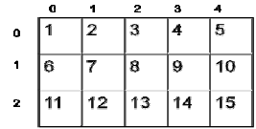
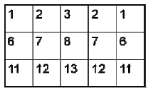
Mirror Our Pix
Let’s try w/numbers
Vertical line of symetry

Slide 4
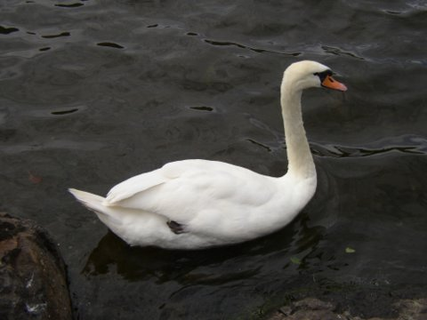
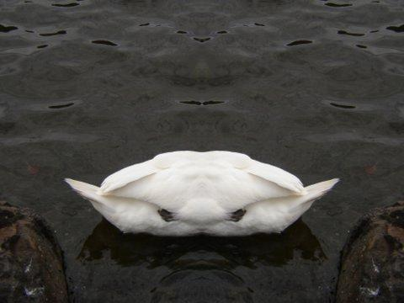
Mirror Our Pix
Let’s try w/numbers
Vertical line of symmetry
Example:

Slide 5
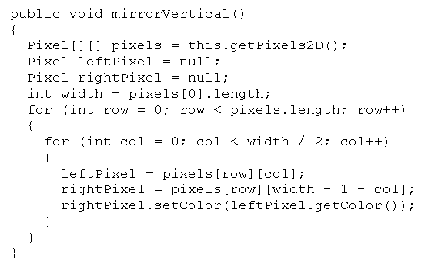
Mirror Our Pix

Slide 6
Mirror Our Pix
vertical line – go through all of the rows
and half of the columns

Slide 7
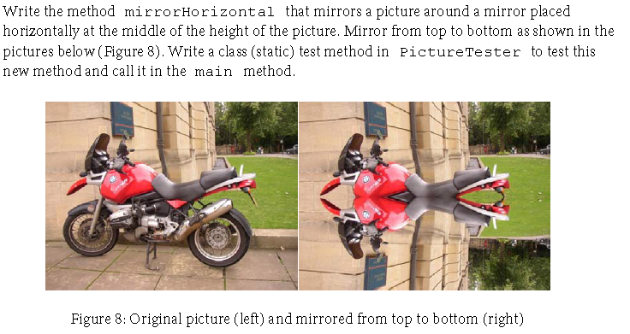
Lab – Mirroring Pix
Test your code!

